Slide 1
AIT Data Science Final Project:
To Dank or Not to Dank
Analyzing and predicting the popularity of memes on Reddit

Slide 2
Motivations
We were looking for a project with some challenges and the potential to base predictions on many different features
We wanted to incorporate some elements of image analysis
We wanted the project to have modern day cultural relevance
Lots of data is available
All of us like memes!
Given the situation with the pandemic, we were curious if and how conversations about it would appear in Reddit memes

Slide 3
Initial Dataset: Limitations
When we first began the project, we were looking for pre-existing datasets to work with
We found a dataset with about 3000 records from 2016…
We saw that most of the memes in the dataset were about the 2016 election and Donald Trump
We decided we wanted more relevant memes and bigger data to train on, so we endeavored to scrape current data from Reddit directly

Slide 4
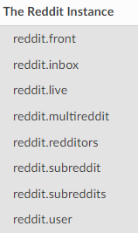
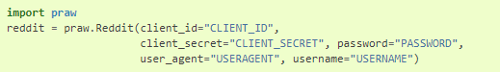
Data Scraping: Praw
Praw = Python Reddit API Wrapper
https://praw.readthedocs.io/en/latest/
The Reddit instance
Notes:
Basically Reddit, you can use it to post things on Reddit

Slide 5
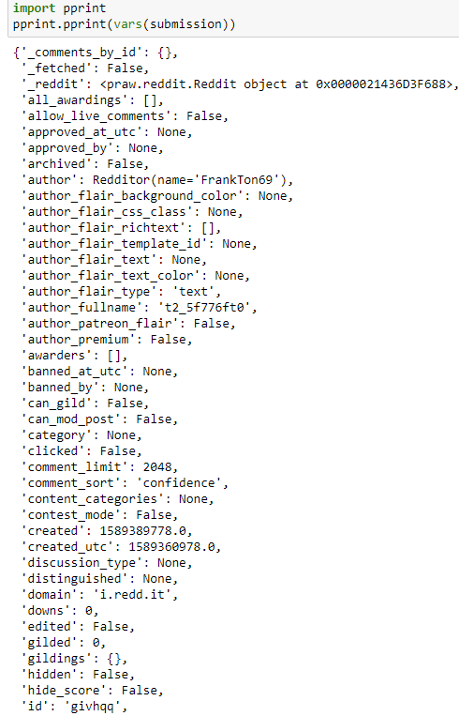
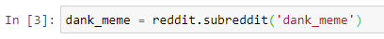
A class for Subreddits
A class for Submissions
Problems with Praw

Slide 6
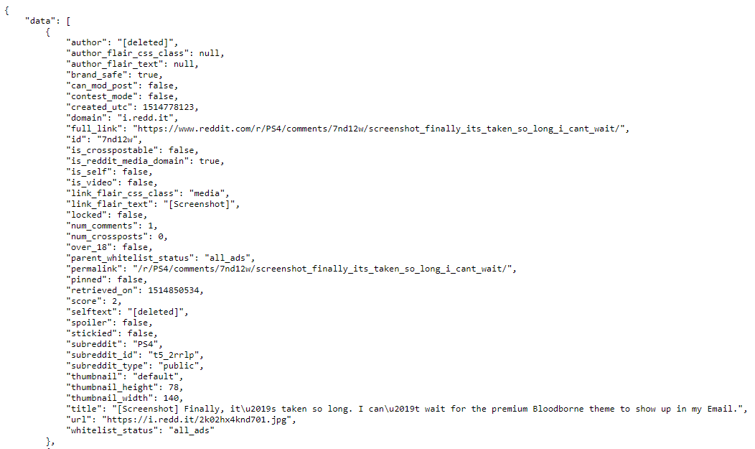
Data Scraping: Pushshift
Analyze large quantities of Reddit data
Grab data for a specific date range in the past
https://api.pushshift.io/reddit/search/submission/?q=screenshot&after=1514764800&before=1517443200&subreddit=PS4
Problems with Pushshift

Slide 7
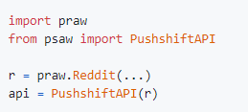
Data Scraping: Psaw
Python Pushshift.io API Wrapper
Use Pushshift search to fetch IDs
Use Praw to fetch objects

Slide 8
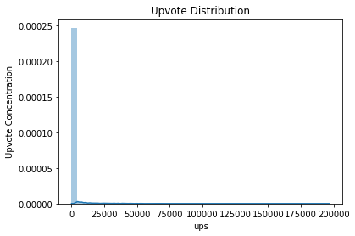
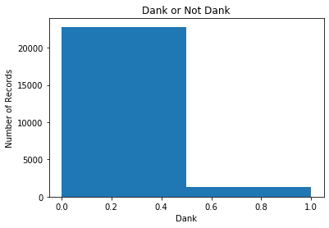
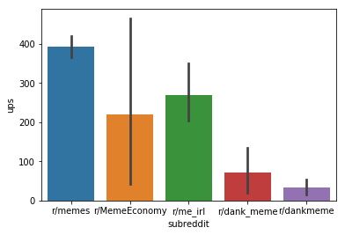
Data Cleaning and Preparation
Get the data ready for analysis
Make data easily reusable
Finding which features were not meaningful
Understanding what we can or cannot do with it

Slide 9
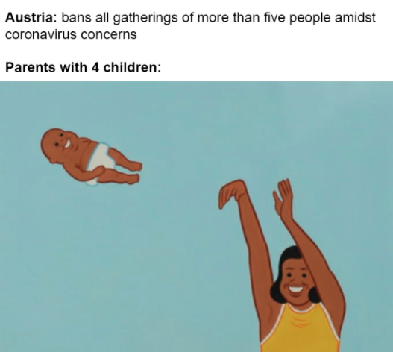
Text Analysis: OCR
OCR stands for Optical Character Recognition
We used a OCR API in order to extract the text contained within the meme images, as meme text plays a big role in the subject and comedy of a meme
Our scraped data contained a column of image links which were passed to the API service
It returned a JSON with the detected text and we cleaned this so that just a string remained
Most of the OCR was quite successful, with occasional misinterpretations or failure to comprehend
Output from the above meme: Austria: bans all gatherings of more than five people amidst coronavirus concerns Parents with 4 children:

Slide 10
Text Analysis: Generalization
The scraped data also contained a column with the caption the meme was posted with, or the title
We combined the title strings with the strings pulled using OCR to gather all text associated
We found a tutorial online which allowed us to gather the root words from a given string
Tokenization: Split the text into sentences and the sentences into words. Lowercase the words and remove punctuation.
Words that have fewer than 3 characters are removed.All stopwords are removed.
Words are lemmatized — words in third person are changed to first person and verbs in past and future tenses are changed into present.
Words are stemmed — words are reduced to their root form.
NLTK and gensim libraries
Output from the OCR: Austria: bans all gatherings of more than five people amidst coronavirus concerns Parents with 4 children:
['austria', 'ban', 'gather', 'peopl', 'ban', 'gather', 'peopl', 'amidst', 'coronavirus', 'concern', 'parent', 'children']

Slide 11
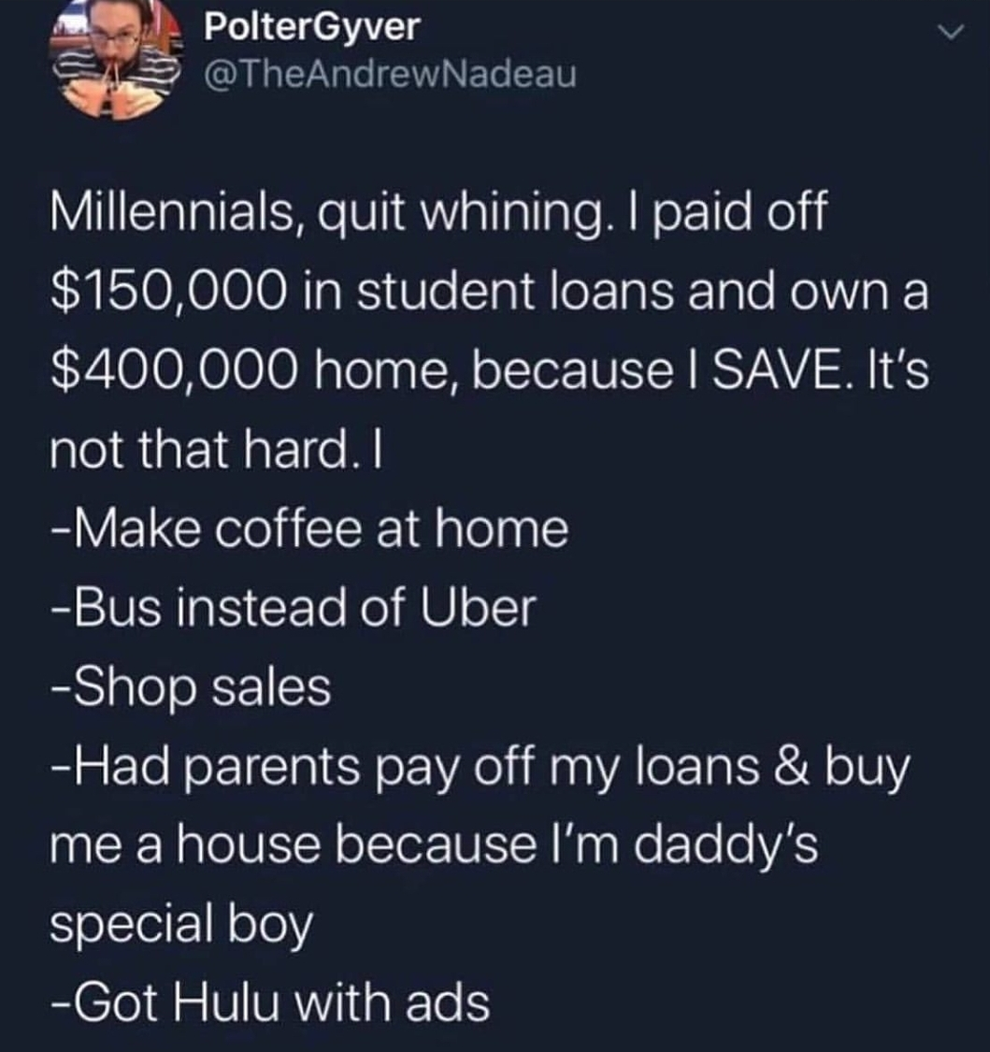
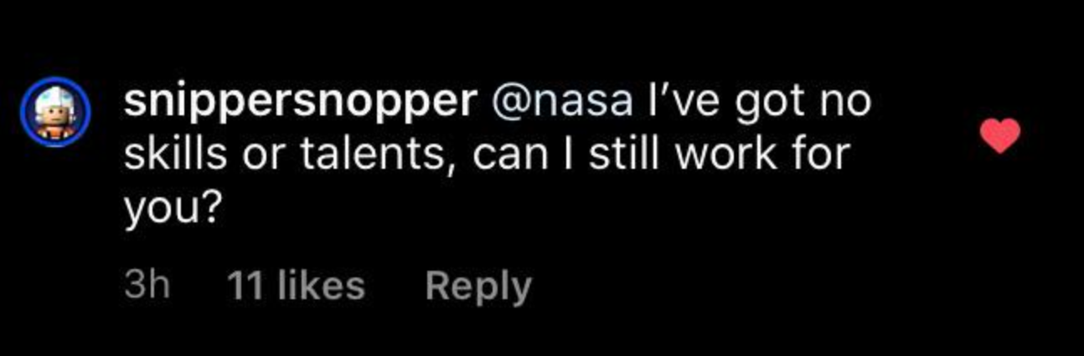
Text Analysis: Sentiment Calculation
We found yet another tutorial online for Sentiment Analysis using Deep Learning
Sentiment refers to the tone of the meme text: is it positive (happy) or negative (sad/scary)?
Sentiment score ranges from 0 (the most negative) to 1 (the most positive)
We used a pre-built model which is built with a Recurrent Neural Network
known as LSTM (Long Short Term Memory)
This network remembers the sequences of past words in order to make a prediction
about the sentiment of new words
The model was trained on large dictionaries with hundreds of thousands of words
which were already scored for sentiments
The sentiment calculations seemed to be quite accurate, though many memes found
themselves scoring around the middle, 0.5
0.81 sentiment score 0.22 sentiment score

Slide 12
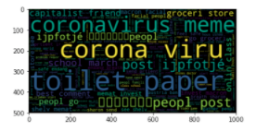
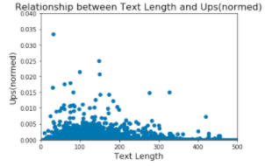
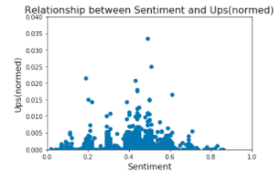
Text Analysis: Basic Understanding
From just the text itself, we were able to tell to detect some patterns and relevancies.
For instance, upon creating a wordcloud with all the words in all the memes, it became obvious what topics were very popular
For example: coronavirus, toilet paper, people, capitalist, invest, post, online class, safe, endanger, world, grocery store, ban, doctor, macron
We also observed some very basic trends when relating the sentiment scores and the word length (number of words in the meme) to upvotes
It seems that memes with less
words are more favorable
It also seems that neutral memes
perform better than extreme ones,
but of the extremes, negative
sentiments perform better

Slide 13
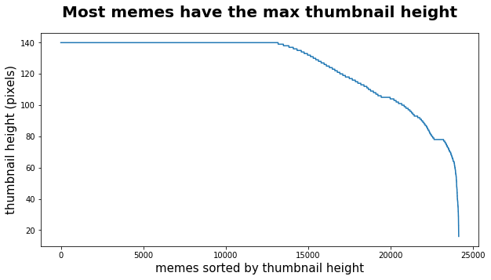
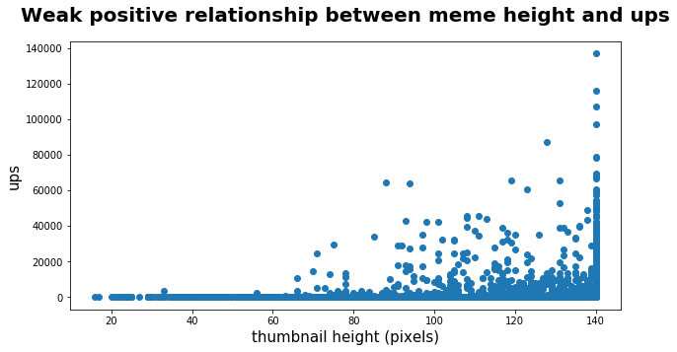
Image analysis:
Simple image content
Human interpretable like color and intensity
Low-level image features
Computer vision features like gradient, texture, color patches
High-level image features
Presence of objects, semantic meaning
Notes:
Bigger the meme the better

Slide 14
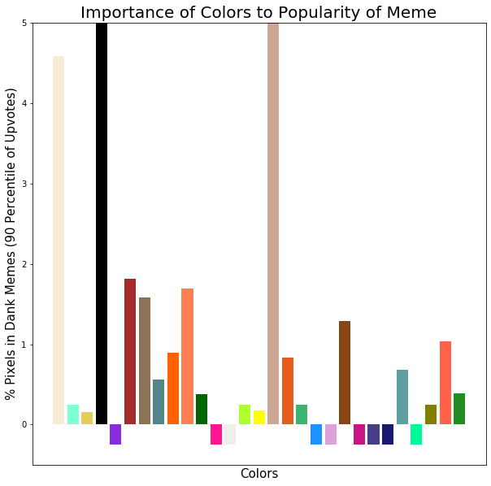
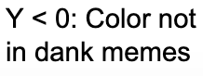
Simple Image Content:
Color!
Extracted color features using using masking technique, opencv
Added attributes: sum amount of color in pixels / total pixels
Conclusion: memes are boring
Other ways to test impact on meme popularity
Notes:
Chart shows the average amount of these colors in the most popular memes, those that fall above the 90th percentile of the data, which got more than 1000 upvotes. Because this plot only shows results for that portion of the data, it could be that this distribution of colors is not unique to popular memes but in fact most memes are brown-gray-red-orangish

Slide 15
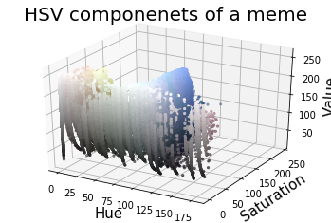
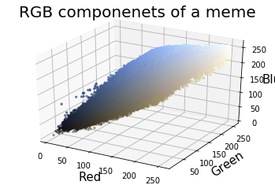
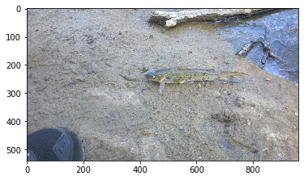
Simple Image Content: Average R-G-B-H-S-V

Slide 16
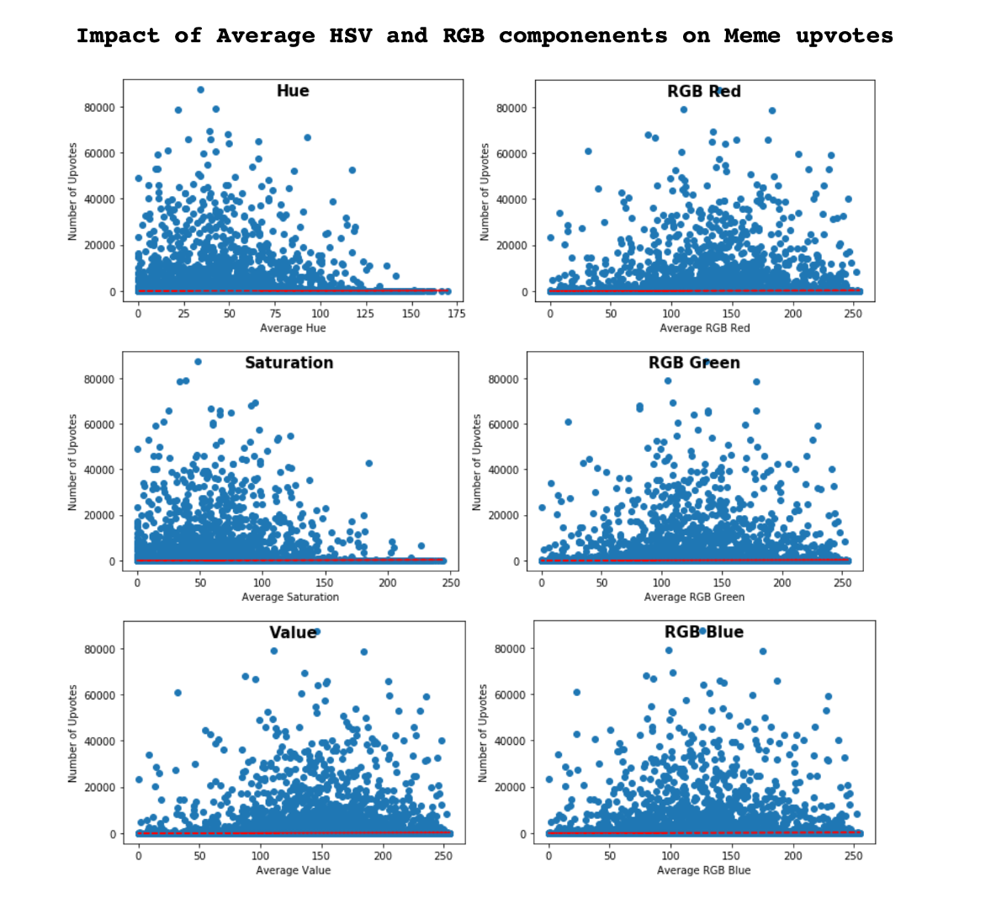
Simple Image Content:
Average R-G-B-H-S-V
Color can be represented in many ways among which HSV and RGB are common
HSV and RGD are more aligned with the human vision system too
Added 6 attributes for the average value of each component in images
Notes:
At least at first glance HSV appears to have a stronger relationship with upvote than RGB, this isn’t surprising because HSV more closely mimics the way that humans perceive color and the memes are made for humans of course. This may indicate the need to look further into low-level image features like the texture of images, or color patches

Slide 17
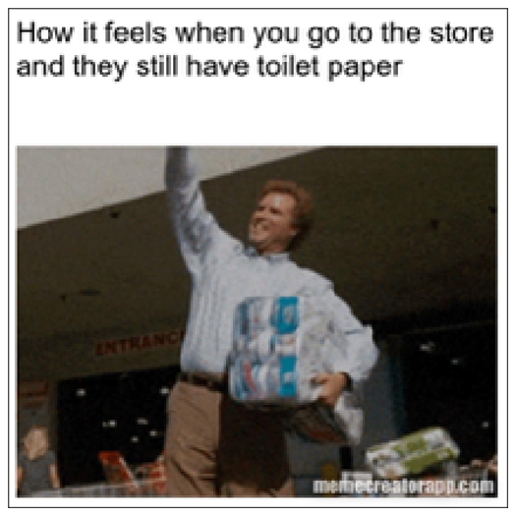
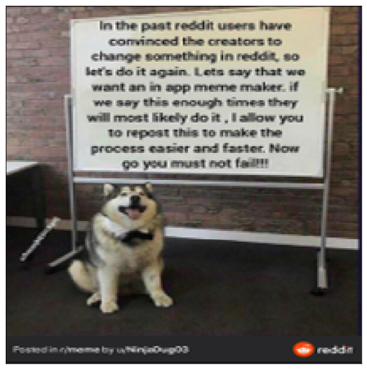
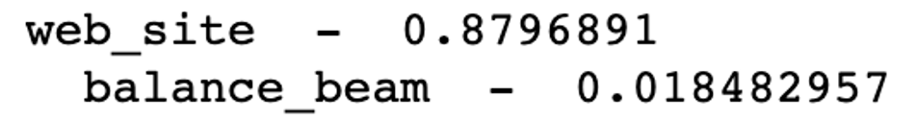
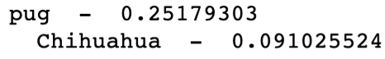
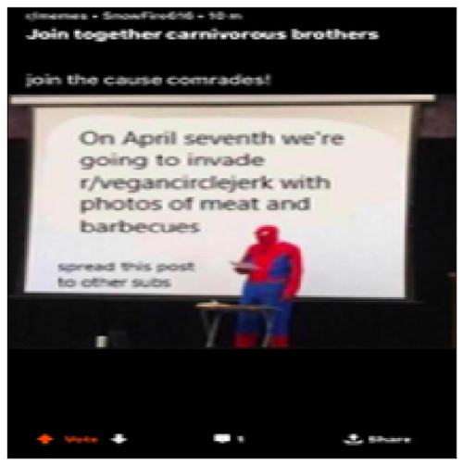
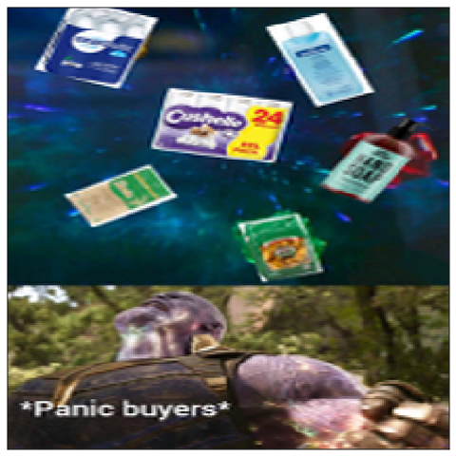
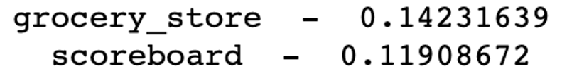
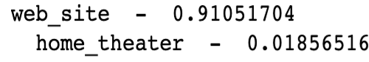
High-level features:
VGG-identified Photo
Content
Is it a chihuahua, website or balance beam?
Used keras pre-trained neural net
Added categorical attributes for the first three most probable features
Notes:
Y < 0: Color not
in dank memes

Slide 18
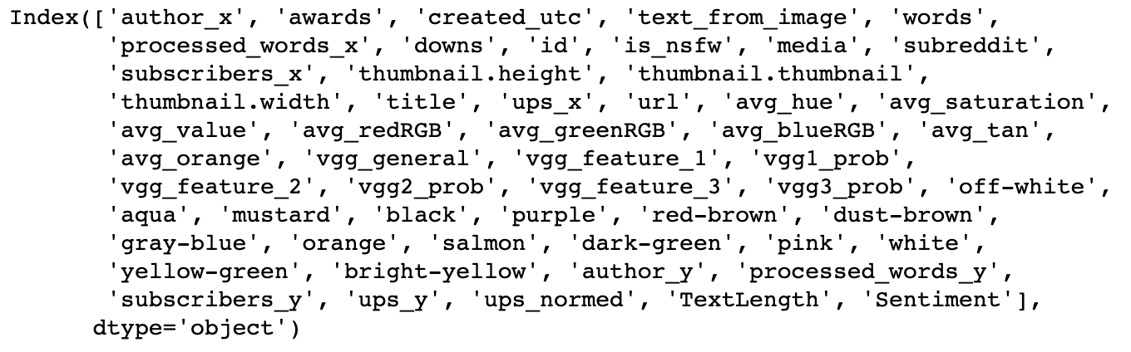
55 -> 70 processed features to train models
‘r/dank_memes’
‘r/memes’
'r/MemeEconomy'r/dankmeme'
‘toilet paper’
‘Corona virus’
‘like’
‘web_site’
‘animals’
‘tech’
‘vehicle’

Slide 19
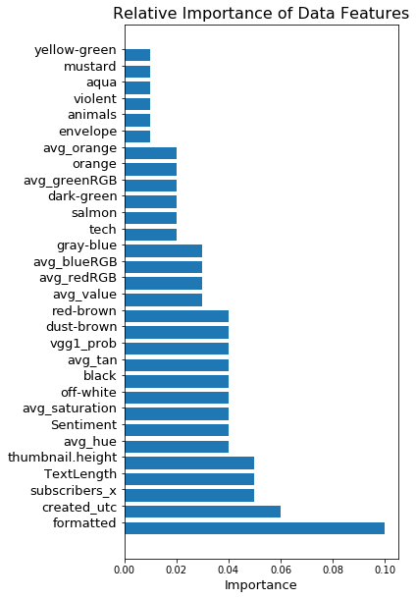
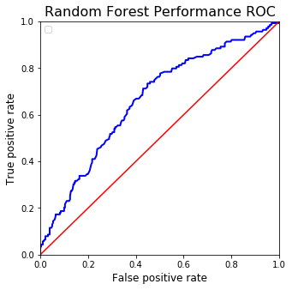
Random Forest Model
Motivation: not sensitive to large amount of attributes, power of ensembles!
Combined and one-hot encode categorical attributes (common words)
Normalized numerical data
Dank or not binary prediction
SMOTE oversampling
Adding / re-formatting features
69.8% prediction accuracy
Notes:
Motivation: not sensitive to many attributes because they don’t split on irrelevant features. In fact, incrementally adding features i saw continuous improvement in model as more features were added
Gini index elaluation of child node purity.
Poor performance due to training on less data? Tried oversampling with SMOTE from imlearn,

Slide 20
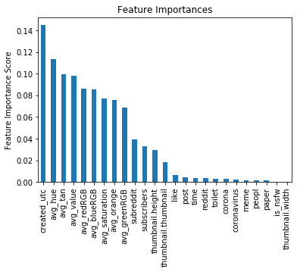
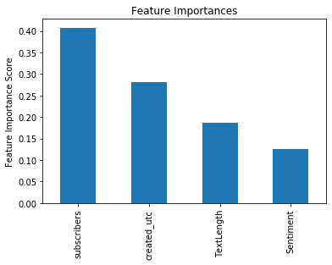
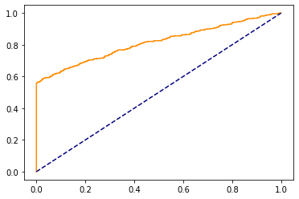
Gradient Boosting Model
Decide which task best suits the data
Feature importance
Parameter Tuning using GridSearchCV
Test performance
96% Accuracy on Test Set

Slide 21

Image Analysis: Convolutional Neural Network
Excel in a wide range of computer vision tasks
Two parts: Convolutional base and Classifier
Hierarchical feature representations

Slide 22
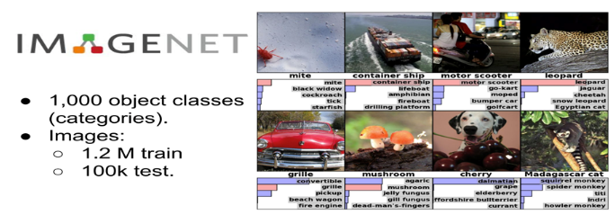
Image Analysis: Transfer Learning
Build accurate models in a timesaving way
ImageNet Large Scale Visual Recognition Challenge
Large dataset of annotated photographs
1 million images and 1,000 object classes
Pre-trained models from published literature
VGG: Oxford Vision Geometry Group (2014)
Inception: Google (2014)
ResNet: Microsoft (2015)

Slide 23
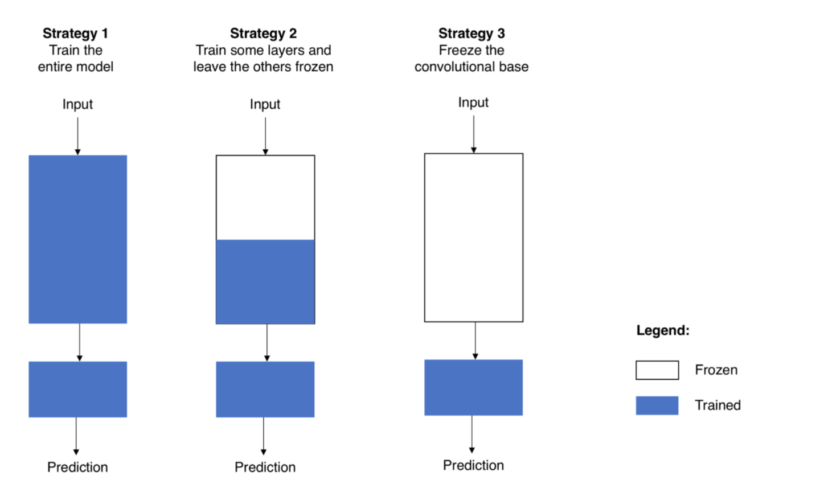
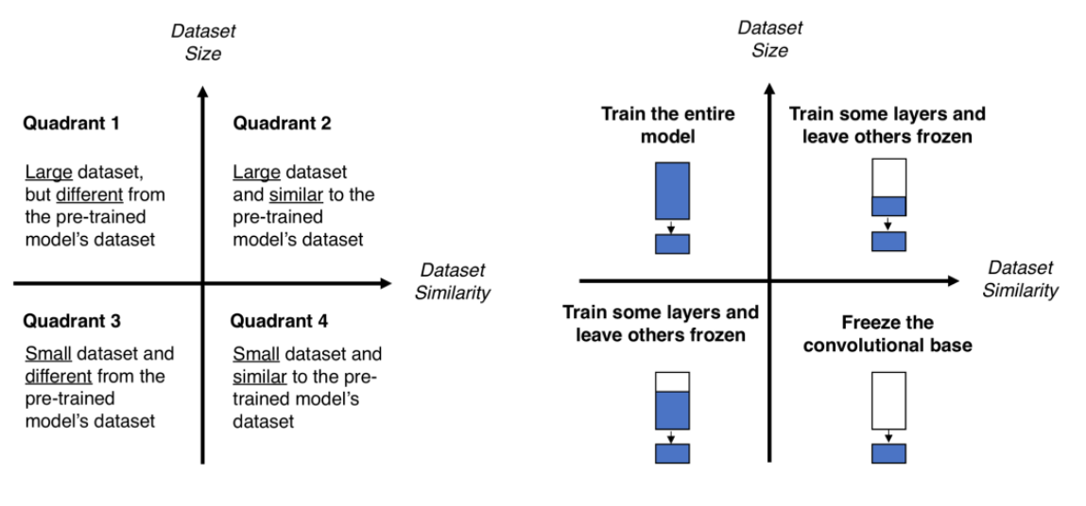
Image Analysis: Approaches

Slide 24
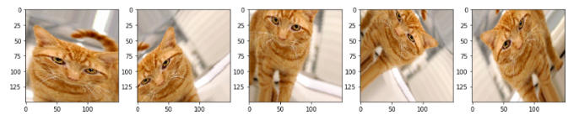
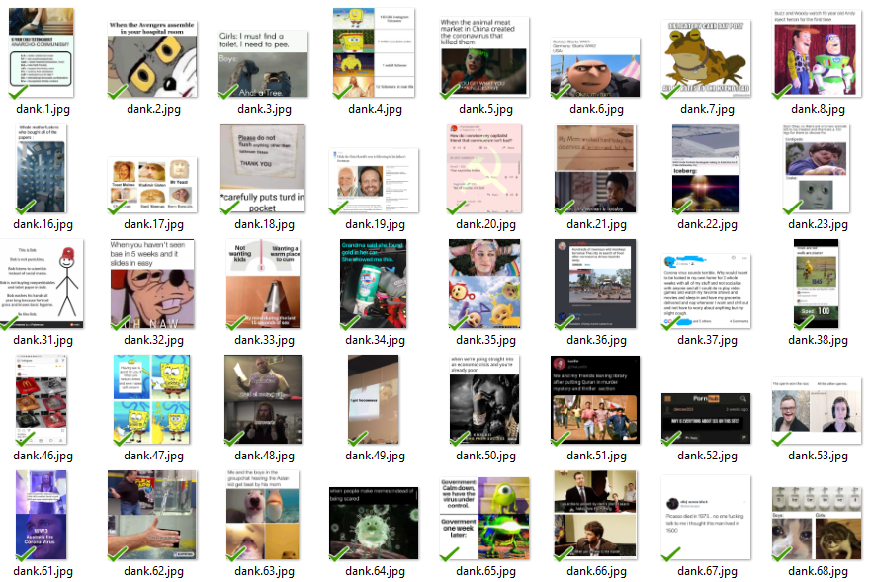
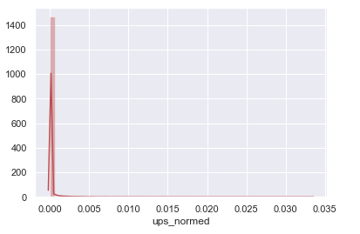
Image Analysis: Data Preparation
Dividing and Sampling the Data
Image Generator

Slide 25
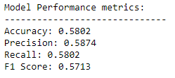
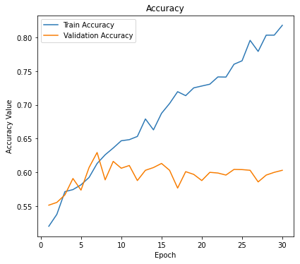
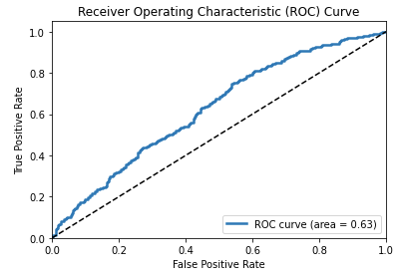
Image Analysis: Models and Results
First model: VGG16 with Image Generator

Slide 26
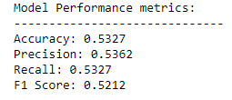
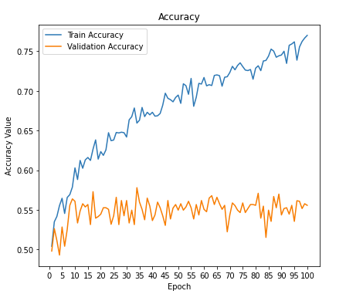
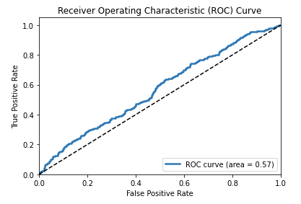
Image Analysis: Models and Results
Second model: Inception with Image Generator

Slide 27
Image Analysis: Models and Results
Third model: Inception with Image Generator

Slide 28
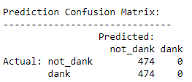


Image Analysis: Models and Results
Fourth model: VGG with Adam Optimizer and Image Generator

Slide 29



Image Analysis: Models and Results
Fifth model: VGG with Image Generator and Higher Dropout

Slide 30



Image Analysis: Models and Results
Sixth model: VGG with Image Generator and Lower Dropout

Slide 31



Image Analysis: Models and Results
Seventh model: VGG with Image Generator and Even Lower Dropout

Slide 32


Your Turn: Classify these memes!
Notes:
Non-dank Dank

Slide 33


Your Turn: Classify these memes!
Notes:
Dank - Non-dank

Slide 34


Your Turn: Classify these memes!
Notes:
Dank - Non-dank

Slide 35
Future Improvements
Gather more data from a larger time frame
Implement interface to upload a meme to a trained model and output prediction results
Gather memes from different sources, like Twitter or Instagram
Formalize findings
Include image findings in sentiment analysis
Use Natural Language Processing to determine broader topics

Slide 36
Final Thoughts
Popular memes are funny. What do our results say about internet humor in general?

